Slide 1
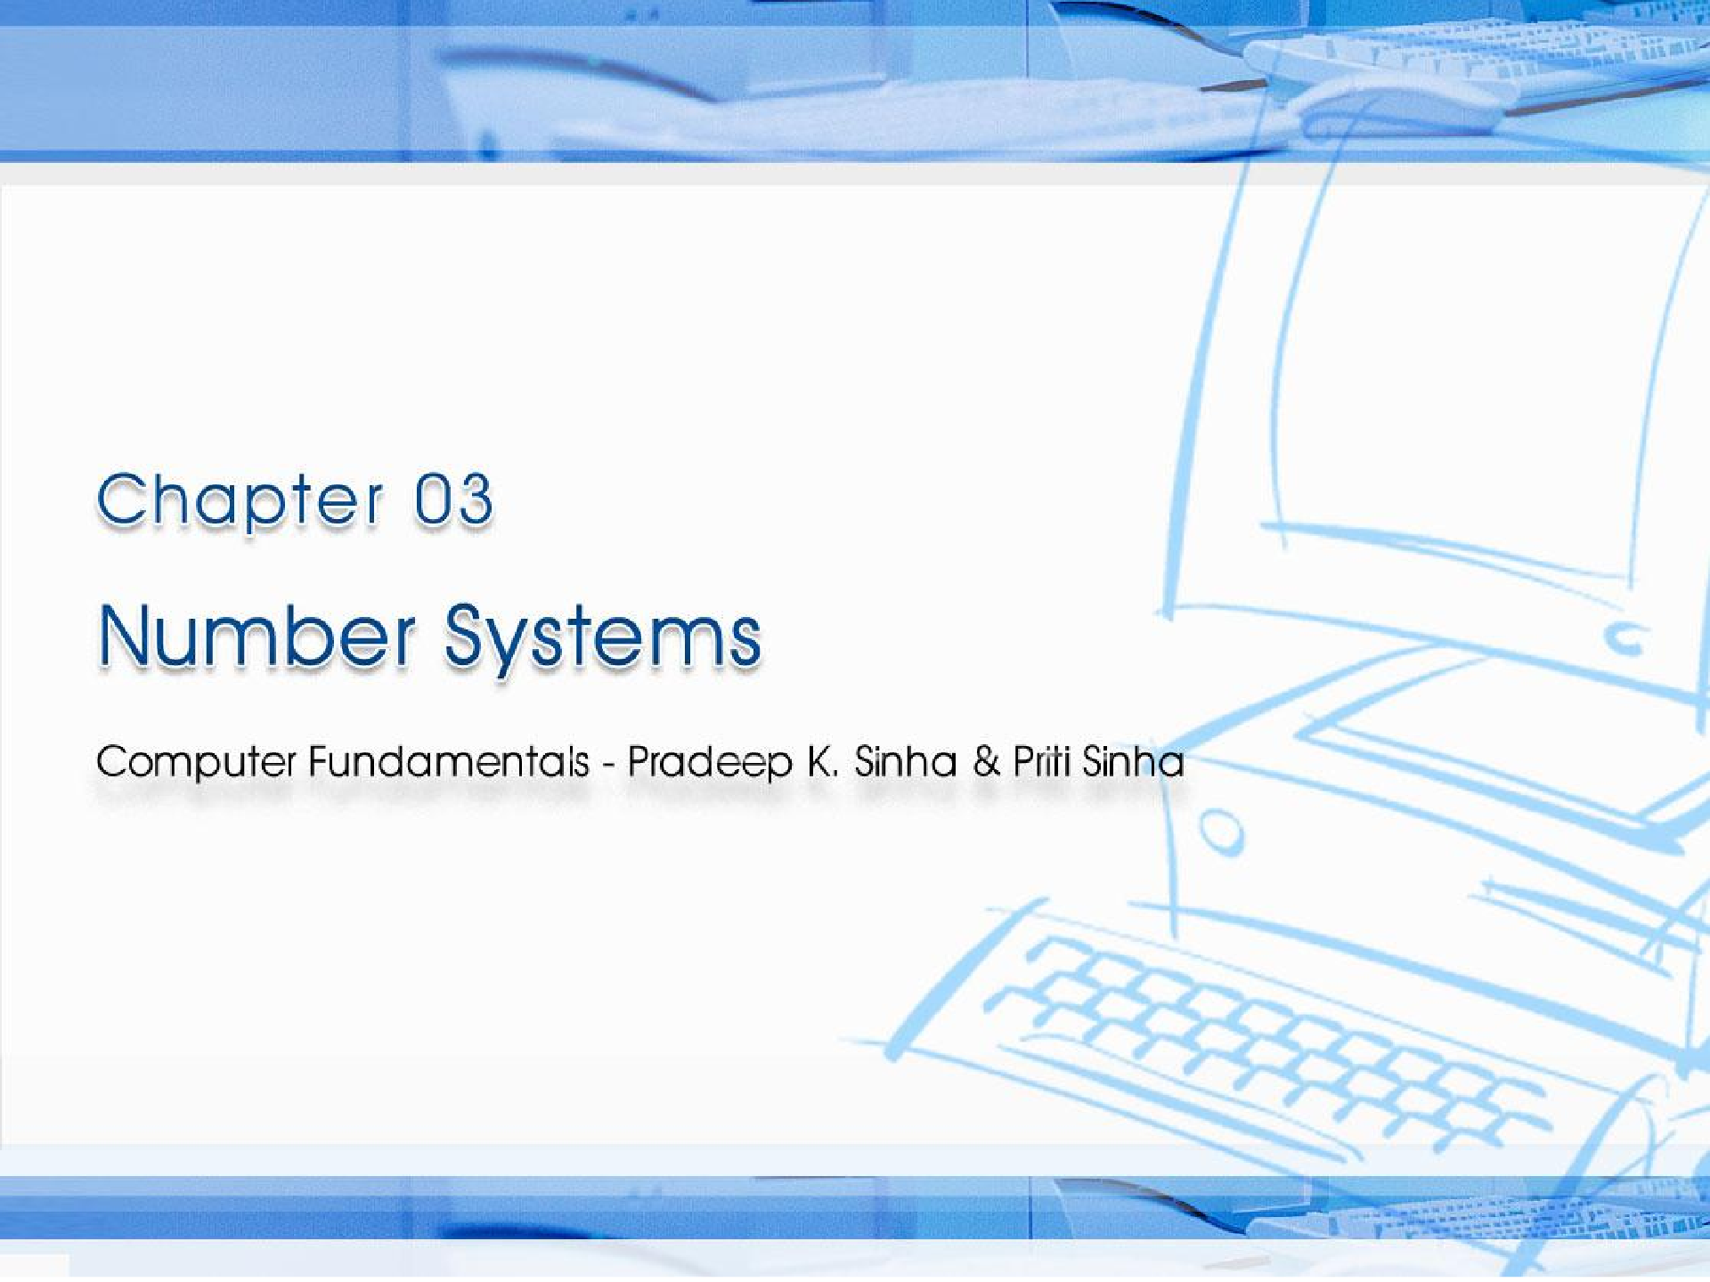
CCoommppuutterer FFununddaammenenttaallss:: PPrradadeeepep KK.. SSiinhanha && PPrriititi SSiinhanha
Ref Page Chapter 3: Number Systems Slide 1/40

Slide 2

Learning Objectives
Computer Fundamentals: Pradeep K. Sinha & Priti Sinha
In this chapter you will learn about:
Non-positional number system
Positional number system
Decimal number system
Binary number system
Octal number system
Hexadecimal number system
(Continued on next slide)
Ref Page 20

Slide 3
Learning Objectives
Computer Fundamentals: Pradeep K. Sinha & Priti Sinha
(Continued from previous slide..)
Convert a number’s base
  Another base to decimal base
  Decimal base to another base
  Some base to another base
Shortcut methods for converting
  Binary to octal number
  Octal to binary number
  Binary to hexadecimal number
  Hexadecimal to binary number
Fractional numbers in binary number system
Ref Page 20

Slide 4
NNuummber Systems
Computer Fundamentals: Pradeep K. Sinha & Priti Sinha
Two types of number systems are:
Non-positional number systems
Positional number systems
Ref Page 20

Slide 5
Non-positional Number Systems
Computer Fundamentals: Pradeep K. Sinha & Priti Sinha
Characteristics
  Use symbols such as I for 1, II for 2, III for 3, IIII for 4, IIIII for 5, etc
  Each symbol represents the same value regardless of its position in the number
  The symbols are simply added to find out the value of a particular number
Difficulty
  It is difficult to perform arithmetic with such a number system
Ref Page 20

Slide 6
Positional Number Systems
Computer Fundamentals: Pradeep K. Sinha & Priti Sinha
Characteristics
  Use only a few symbols called digits
  These symbols represent different values depending on the position they occupy in the number
(Continued on next slide)
Ref Page 20

Slide 7
Positional Number Systems
Computer Fundamentals: Pradeep K. Sinha & Priti Sinha
(Continued from previous slide..)
The value of each digit is determined by:
  The digit itself
  The position of the digit in the number
  The base of the number system
(base = total number of digits in the number system)
The maximum value of a single digit is always equal to one less than the value of the base
Ref Page 21

Slide 8
Decimal Number System
Computer Fundamentals: Pradeep K. Sinha & Priti Sinha
Characteristics
A positional number system
▪ Has 10 symbols or digits (0, 1, 2, 3, 4, 5, 6, 7,
8, 9). Hence, its base = 10
The maximum value of a single digit is 9 (one less than the value of the base)
Each position of a digit represents a specific power of the base (10)
We use this number system in our day-to-day life
(Continued on next slide)
Ref Page 21

Slide 9
Decimal Number System
Computer Fundamentals: Pradeep K. Sinha & Priti Sinha
(Continued from previous slide..)
Example
2586₁₀ = (2 x 10³) + (5 x 10²) + (8 x 10¹) + (6 x 10⁰)
= 2000 + 500 + 80 + 6
Ref Page 21

Slide 10
BBiinary Number System
Computer Fundamentals: Pradeep K. Sinha & Priti Sinha
Characteristics
A positional number system
Has only 2 symbols or digits (0 and 1). base = 2
Hence its
The maximum value of a single digit is 1 (one less than the value of the base)
Each position of a digit represents a specific power of the base (2)
This number system is used in computers
(Continued on next slide)
Ref Page 21

Slide 11
BBiinary Number System
Computer Fundamentals: Pradeep K. Sinha & Priti Sinha
(Continued from previous slide..)
Example
10101₂ = (1 x 2⁴) + (0 x 2³) + (1 x 2²) + (0 x 2¹) x (1 x 2⁰)
= 16 + 0 + 4 + 0 + 1
= 21₁₀
Ref Page 21

Slide 12
Representing Numbers in Different Number Systems
Computer Fundamentals: Pradeep K. Sinha & Priti Sinha
In order to be specific about which number system we are referring to, it is a common practice to indicate the base as a subscript. Thus, we write:
10101₂ = 21₁₀
Ref Page 21

Slide 13
Computer Fundamentals: Pradeep K. Sinha & Priti Sinha
Bit
Bit stands for binary digit
A bit in computer terminology means either a 0 or a 1
A binary number consisting of n bits is called an n-bit number
Ref Page 22

Slide 14
Octal Number System
Computer Fundamentals: Pradeep K. Sinha & Priti Sinha
Characteristics
A positional number system
Has total 8 symbols or digits (0, 1, 2, 3, 4, 5, 6, 7). Hence, its base = 8
The maximum value of a single digit is 7 (one less than the value of the base
Each position of a digit represents a specific power of the base (8)
(Continued on next slide)
Ref Page 22

Slide 15
Octal Number System
Computer Fundamentals: Pradeep K. Sinha & Priti Sinha
(Continued from previous slide..)
Since there are only 8 digits, 3 bits (2³ = 8) are sufficient to represent any octal number in binary
Example
2057₈
= (2 x 8³) + (0 x 8²) + (5 x 8¹) + (7 x 8⁰)
= 1024 + 0 + 40 + 7
= 1071₁₀
Ref Page 22

Slide 16
HHeexadecimal Number System
Computer Fundamentals: Pradeep K. Sinha & Priti Sinha
Characteristics
A positional number system
Has total 16 symbols or digits (0, 1, 2, 3, 4, 5, 6, 7, 8, 9, A, B, C, D, E, F). Hence its base = 16
The symbols A, B, C, D, E and F represent the decimal values 10, 11, 12, 13, 14 and 15 respectively
The maximum value of a single digit is 15 (one less than the value of the base)
(Continued on next slide)
Ref Page 22

Slide 17
HHeexadecimal Number System
Computer Fundamentals: Pradeep K. Sinha & Priti Sinha
(Continued from previous slide..)
Each position of a digit represents a specific power of the base (16)
Since there are only 16 digits, 4 bits (2⁴ = 16) are sufficient to represent any hexadecimal number in binary
Example
1AF₁₆
= (1 x 16²) + (A x 16¹) + (F x 16⁰)
= 1 x 256 + 10 x 16 + 15 x 1
= 256 + 160 + 15
= 431₁₀
Ref Page 22

Slide 18
Converting a Number of Another Base to a Decimal Number
Computer Fundamentals: Pradeep K. Sinha & Priti Sinha
Method
Step 1:
Determine the column (positional) value of each digit
Step 2:
Multiply the obtained column values by the digits in the corresponding columns
Step 3:
Calculate the sum of these products
(Continued on next slide)
Ref Page 23

Slide 19
Converting a Number of Another Base to a Decimal Number
Computer Fundamentals: Pradeep K. Sinha & Priti Sinha
(Continued from previous slide..)
Example
4706₈ = ?₁₀
Common values multiplied by the
corresponding digits
4706₈ = 4 x 8³ + 7 x 8² + 0 x 8¹ + 6 x 8⁰
= 4 x 512 + 7 x 64 + 0 + 6 x 1
= 2048 + 448 + 0 + 6
= 2502₁₀
Sum of these products
Ref Page 23

Slide 20
Converting a Decimal Number to a Number of Another Base
Computer Fundamentals: Pradeep K. Sinha & Priti Sinha
Division-Remainder Method
Step 1:
Divide the decimal number to be converted by the value of the new base
Step | 2: | Record the remainder | from Step 1 as | the
 |  | rightmost digit (least | significant digit) of | the
new base number
Step 3:
Divide the quotient of the previous divide by the new base
(Continued on next slide)
Ref Page 25

Slide 21
Converting a Decimal Number to a Number of Another Base
(Continued from previous slide..)
Computer Fundamentals: Pradeep K. Sinha & Priti Sinha
Step 4:
Record the remainder from Step 3 as the next digit (to the left) of the new base number
Repeat Steps 3 and 4, recording remainders from right to left, until the quotient becomes zero in Step 3
Note that the last remainder thus obtained will be the most significant digit (MSD) of the new base number
(Continued on next slide)
Ref Page 25

Slide 22
Converting a Decimal Number to a Number of Another Base
Computer Fundamentals: Pradeep K. Sinha & Priti Sinha
(Continued from previous slide..)
Example
952₁₀ = ?₈
Solution:
8 | 952 | Remainder
 | 119 | s ₀
 | 14 | 7
 | 1 | 6
 | 0 | 1
Hence, 952₁₀ = 1670₈
Ref Page 26

Slide 23
Converting a Number of Some Base to a Number of Another Base
Computer Fundamentals: Pradeep K. Sinha & Priti Sinha
Method
Step
1: Convert the original number (base 10)
number
to a decimal
Step 2:
Convert the decimal number so obtained to the new base number
(Continued on next slide)
Ref Page 27

Slide 24
Converting a Number of Some Base of Another Base
Computer Fundamentals: Pradeep K. Sinha & Priti Sinha
to a Number
(Continued from previous slide..)
Example
545₆ = ?₄
Solution:
Step 1: Convert from base 6 to base 10
545₆ = 5 x 6² + 4 x 6¹ + 5 x 6⁰
= 5 x 36 + 4 x 6 + 5 x 1
= 180 + 24 + 5
= 209₁₀
(Continued on next slide)
Ref Page 27

Slide 25
Converting a Number of Some Base of Another Base
Computer Fundamentals: Pradeep K. Sinha & Priti Sinha
to a Number
(Continued from previous slide..)
Step 2:
Convert 209₁₀ to base 4
4 209
Remainders
1
0
1
3
52
13
3
0
Hence, 209₁₀ = 3101₄
So, 545₆ = 209₁₀ = 3101₄
Thus, 545₆ = 3101₄
Ref Page 28

Slide 26
Shortcut Method for Converting a Binary Number to its Equivalent Octal Number
Computer Fundamentals: Pradeep K. Sinha & Priti Sinha
Method
Step 1:
Divide the digits into groups of three starting from the right
Step 2:
Convert each group of three binary digits to one octal digit using the method of binary to decimal conversion
(Continued on next slide)
Ref Page 29

Slide 27
Shortcut Method for Converting a Binary Number to its Equivalent Octal Number
Computer Fundamentals: Pradeep K. Sinha & Priti Sinha
(Continued from previous slide..)
Example
1101010₂ = ?₈
Step 1:
Divide the binary digits into groups of 3 starting from right
001 101 010
Convert each group into one octal digit
Step 2:
001₂ = 0 x 2² + 0 x 2¹ + 1 x 2⁰ = 1
101₂ = 1 x 2² + 0 x 2¹ + 1 x 2⁰ = 5
010₂ = 0 x 2² + 1 x 2¹ + 0 x 2⁰ = 2
Hence, 1101010₂ = 152₈
Ref Page 29

Slide 28
Shortcut Method for Converting an Octal Number to Its Equivalent Binary Number
Computer Fundamentals: Pradeep K. Sinha & Priti Sinha
Method
Step 1:
Convert each octal digit to a 3 digit binary number (the octal digits may be treated as decimal for this conversion)
Step
2: Combine all the resulting (of 3 digits each) into a number
binary single
groups binary
(Continued on next slide)
Ref Page 30

Slide 29
Shortcut Method for Converting an Octal Number to Its Equivalent Binary Number
Computer Fundamentals: Pradeep K. Sinha & Priti Sinha
(Continued from previous slide..)
Example
562₈ = ?₂
Step 1:
Convert each octal digit to 3 binary digits 5₈ = 101₂, 6₈ = 110₂, 2₈ = 010₂
Combine the binary groups
Step 2:
562₈ | = 101 | 110 | 010
 | 5 | 6 | 2
Hence, 562₈ = 101110010₂
Ref Page 30

Slide 30
Shortcut Method for Converting a Binary Number to its Equivalent Hexadecimal Number
Computer Fundamentals: Pradeep K. Sinha & Priti Sinha
Method
Step 1:
Divide the binary digits into groups of four starting from the right
Combine each group of four binary digits to one hexadecimal digit
Step 2:
(Continued on next slide)
Ref Page 30

Slide 31
Shortcut Method for Converting a Binary Number to its Equivalent Hexadecimal Number
Computer Fundamentals: Pradeep K. Sinha & Priti Sinha
(Continued from previous slide..)
Example
111101₂ = ?₁₆
Step 1:
Divide the binary digits into groups of four starting from the right
0011 1101
Convert each group into a hexadecimal digit
0011₂ = 0 x 2³ + 0 x 2² + 1 x 2¹ + 1 x 2⁰ = 3₁₀ = 3₁₆
1101₂ = 1 x 2³ + 1 x 2² + 0 x 2¹ + 1 x 2⁰ = 3₁₀ = D₁₆
Step 2:
Hence, 111101₂ = 3D₁₆
Ref Page 31

Slide 32
Shortcut Method for Converting a Hexadecimal Number to its Equivalent Binary Number
Computer Fundamentals: Pradeep K. Sinha & Priti Sinha
Method
Step 1: Convert the decimal equivalent of each hexadecimal digit to a 4 digit binary number
Step 2: Combine all the resulting binary groups
(of 4 digits each) in a single binary number
(Continued on next slide)
Ref Page 31

Slide 33
Shortcut Method for Converting a Hexadecimal Number to its Equivalent Binary Number
Computer Fundamentals: Pradeep K. Sinha & Priti Sinha
(Continued from previous slide..)
Example
2AB₁₆ = ?₂
Step 1: Convert each hexadecimal digit to a 4 digit binary number
2₁₆ =
²10
= 0010₂
A₁₆ = 10₁₀ = 1010₂
B₁₆ = 11₁₀ = 1011₂
Ref Page 32

Slide 34
Shortcut Method for Converting a Hexadecimal Number to its Equivalent Binary Number
(Continued from previous slide..)
Computer Fundamentals: Pradeep K. Sinha & Priti Sinha
Step 2: Combine the binary groups
2AB₁₆ = 0010 | 1010 | 1011
2 | A | B
Hence, 2AB₁₆ = 001010101011₂
Ref Page 32

Slide 35
Fractional Numbers
Computer Fundamentals: Pradeep K. Sinha & Priti Sinha
Fractional numbers are formed same way as decimal number system
In general, a number in a number system with base b
would be written as:
ªn ªn-1^{… a}0 ^{. a}-1 ª-2 ^{… a}-m
And would be interpreted to mean:
a_{n} x b^{n} + a_{n-1} x b^{n-1} + … + a₀ x b⁰ + a₋₁ x b⁻¹ + a₋₂ x b⁻² +
… + a_{-m} x b^{-m}
The symbols a_{n},
…, in above representation
ªn-1^{, a}-m
should be one of the b symbols allowed in the number system
Ref Page 33

Slide 36
Formation of Fractional Numbers in Binary Number System (Example)
Computer Fundamentals: Pradeep K. Sinha & Priti Sinha
Binary Point
Position
4 | 3 | 2 | 1 | 0 | . -1 | -2 | -3 | -4
₂4 | ₂3 | ₂2 | ₂1 | ₂0 | ₂-1 | ₂-2 | ₂-3 | ₂-4
Position Value
Quantity Represented
16 8
4
2
1
1_{/2} 1_{/4} 1_{/8}
^{1/}16
(Continued on next slide)
Ref Page 33

Slide 37
Formation of Fractional Numbers in Binary Number System (Example)
(Continued from previous slide..)
Computer Fundamentals: Pradeep K. Sinha & Priti Sinha
Example
110.101₂
= 1 x 2² + 1 x 2¹ + 0 x 2⁰ + 1 x 2⁻¹ + 0 x 2⁻² + 1 x 2⁻³
= 4 + 2 + 0 + 0.5 + 0 + 0.125
= 6.625₁₀
Ref Page 33

Slide 38
Formation of Fractional Numbers in Octal Number System (Example)
Computer Fundamentals: Pradeep K. Sinha & Priti Sinha
Octal Point
Position
3
2 1 0 . -1 -2
-3
Position Value
₈3
₈2 ₈1 ₈0
₈-1
₈-2
₈-3
Quantity Represented
512 64
8
1
1_{/8}
^{1/}64
^{1/}512
(Continued on next slide)
Ref Page 33

Slide 39
Formation of Fractional Numbers in Octal Number System (Example)
Computer Fundamentals: Pradeep K. Sinha & Priti Sinha
(Continued from previous slide..)
Example
127.54₈ = 1 x 8² + 2 x 8¹ + 7 x 8⁰ + 5 x 8⁻¹ + 4 x 8⁻²
= 64 + 16 + 7 + ⁵/₈ + ⁴/₆₄
= 87 + 0.625 + 0.0625
= 87.6875₁₀
Ref Page 33

Slide 40
Key Words/Phrases
Computer Fundamentals: Pradeep K. Sinha & Priti Sinha
Base
Binary number system
Binary point
Bit
Decimal number system
Division-Remainder technique
Fractional numbers
Hexadecimal number system
Least Significant Digit (LSD)
Memory dump
Most Significant Digit (MSD)
Non-positional number system
Number system
Octal number system
Positional number system
Ref Page 34

